Slide 1

Reporting Service
Software Architecture Project

Slide 2
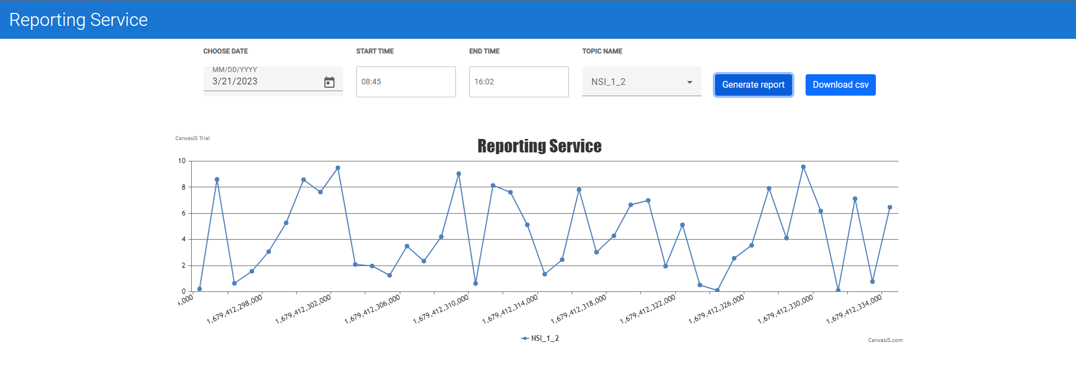
Reporting Service Software Architecture Project

Slide 3
Team role:
Dang Tu Nguyen: Scrum Master
Manh Tien Dinh: BackEnd developer
Quoc Nam Le: BackEnd developer
Hoang Long Nguyen: BackEnd developer
Thanh Tung Le: UI developer
Phuong Thao Do: UI developer

Slide 4
Requirements
Reporter Service (RS): this service generates a report of all values of NSI
It subscribes to all NSI_x_y topics and receives the latest value of them and generates a CSV file of each.
A client code can communicate with this service and visualize the values of NSI per topic. The visualization may be as a table or graph or both
The visualization could be sorted based on the first index of the NSI topic. For example, all NSI_x_y values for a certain value of x and all values of y in one column and sorted descending on y.

Slide 5
Environment
BackEnd:
Spring boot: 2.2.7.RELEASE
Java: 11
Spring-cloud version: Hoxton.RELEASE
Kafka-streams : 2.2.2
MongoDB
FrontEnd:
Angular: 15
Bootstrap 4
Webpack
TypeScript

Slide 6
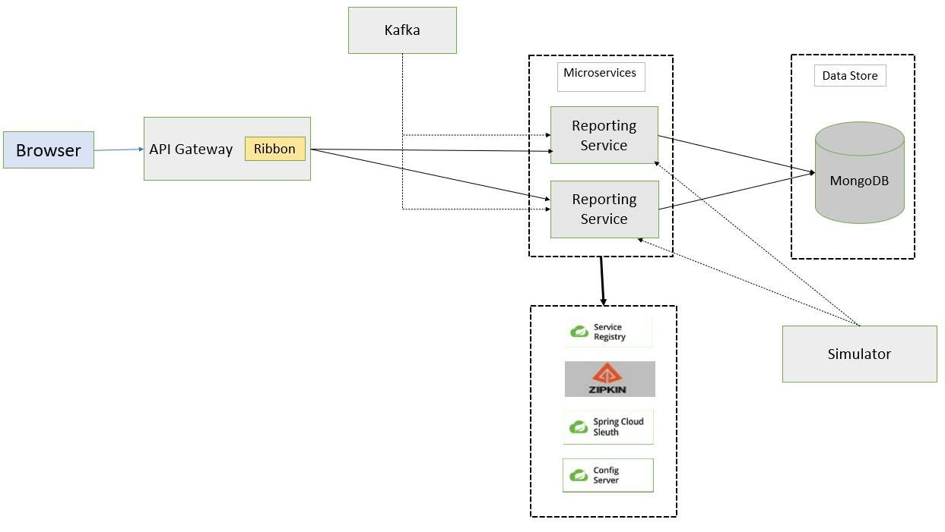
Software Architecture

Slide 7
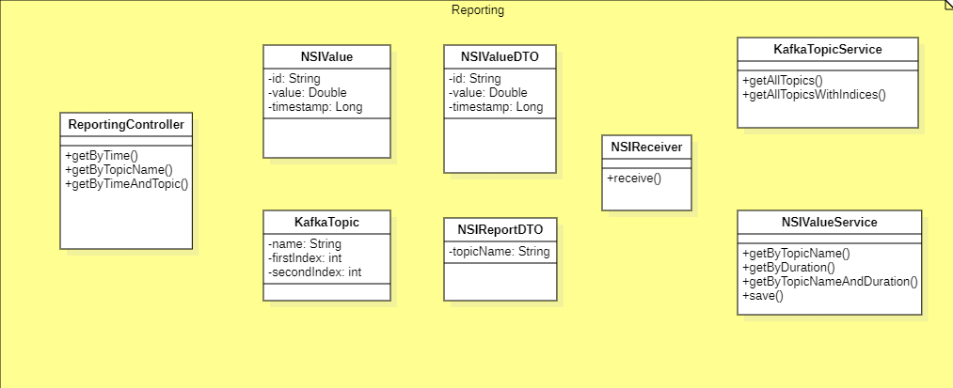
Class Diagram

Slide 8
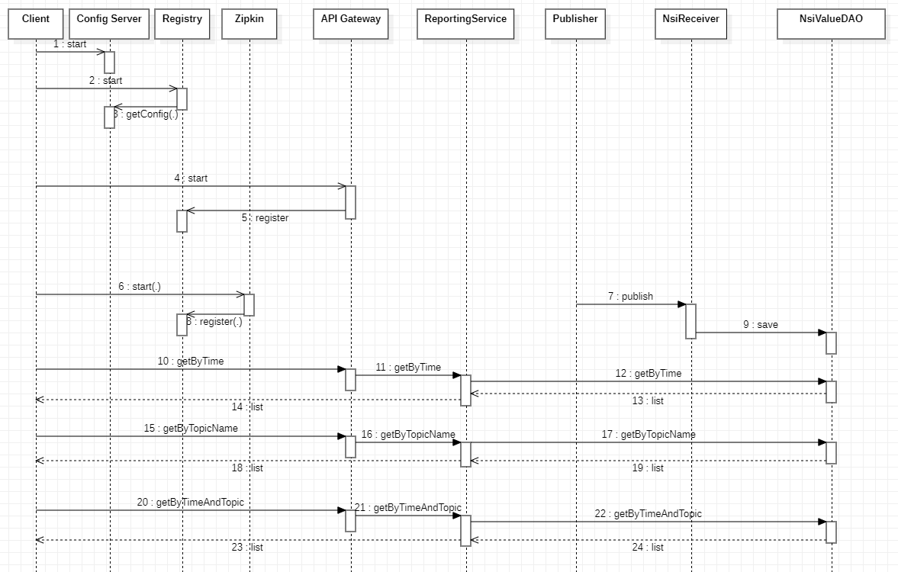
Sequence Diagram

Slide 9
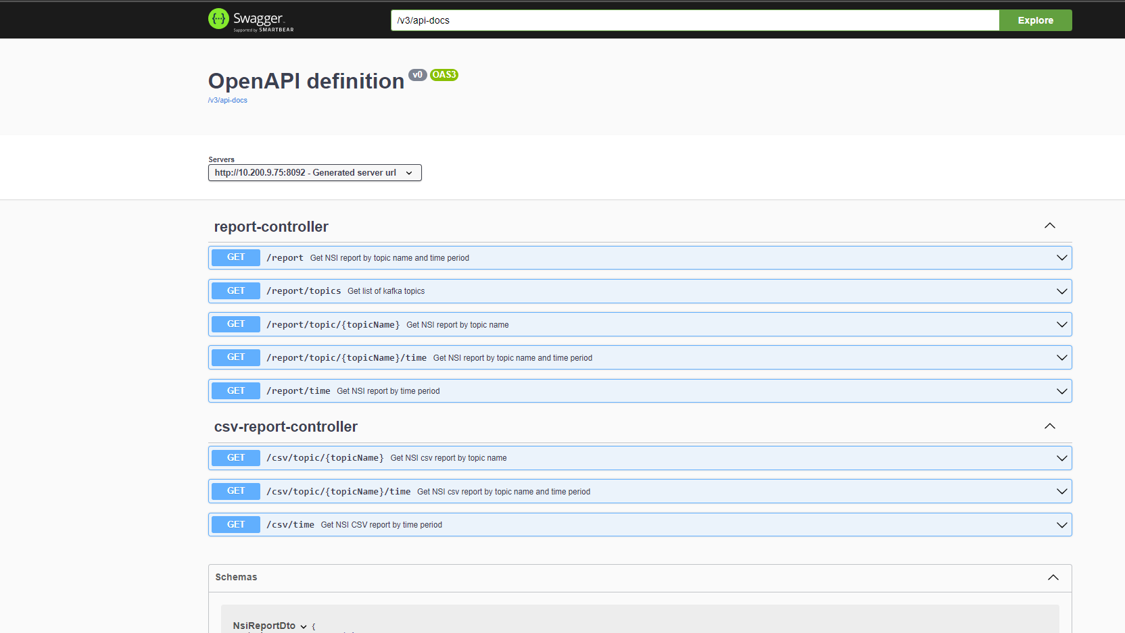
Documentation
Swagger UI

